Slide 1
Laser Frequency Stabilization
Dr. Wolfgang Korsch
Will Bodron
Charlotte Zehnder

Slide 2
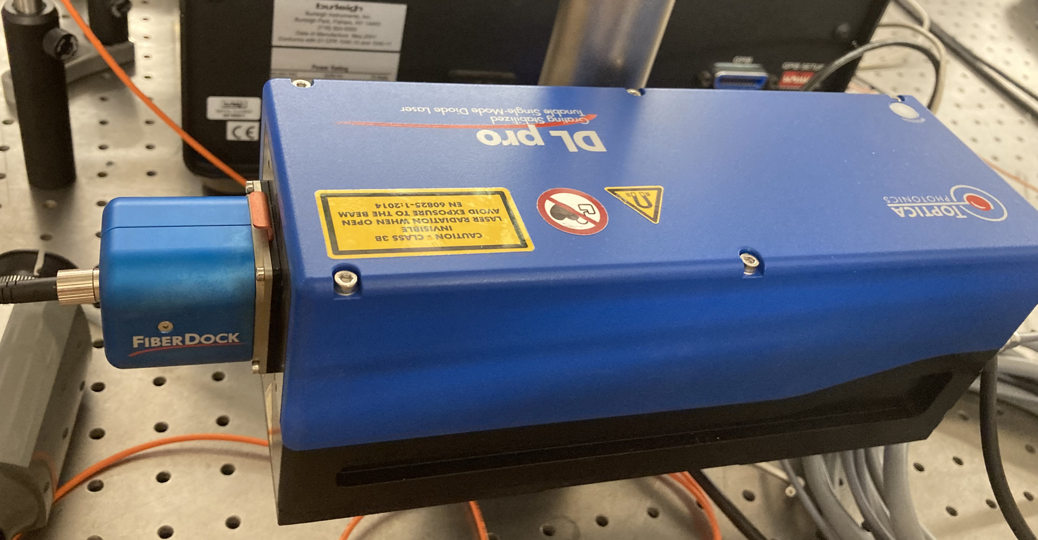
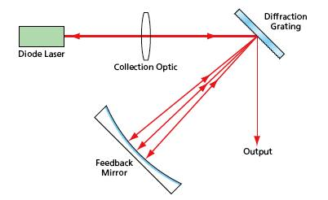
Why Is Stabilization needed?
Tunable Laser
Environmental Changes
https://www.techbriefs.com/component/content/article/tb/pub/techbriefs/physical-sciences/6433

Slide 3
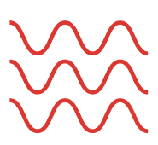
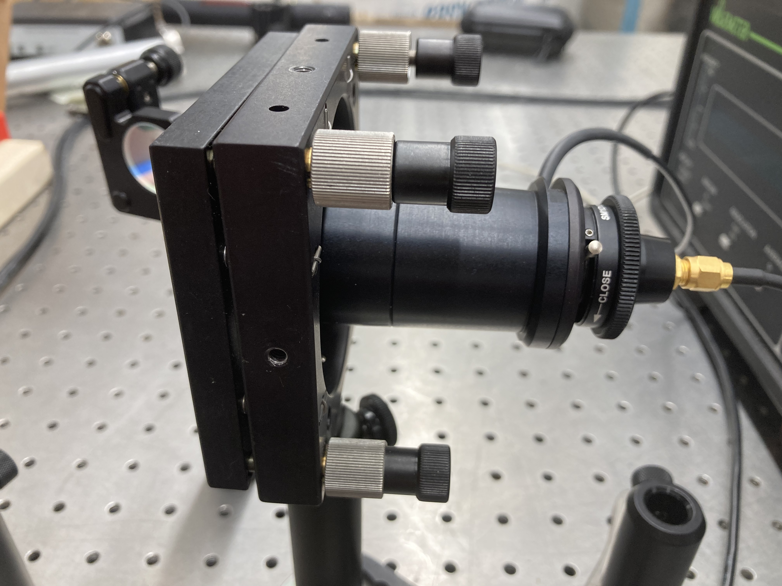
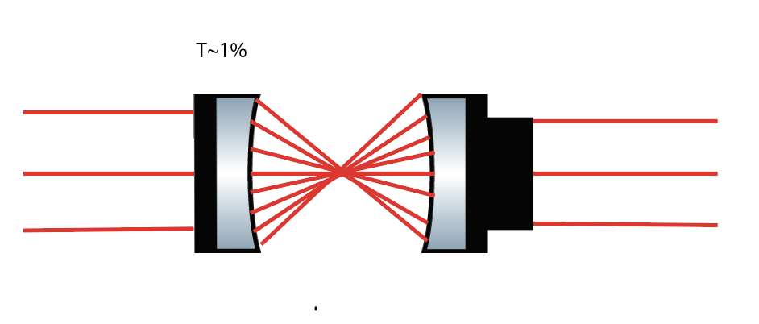
Fabry Perot Interferometer

Slide 4
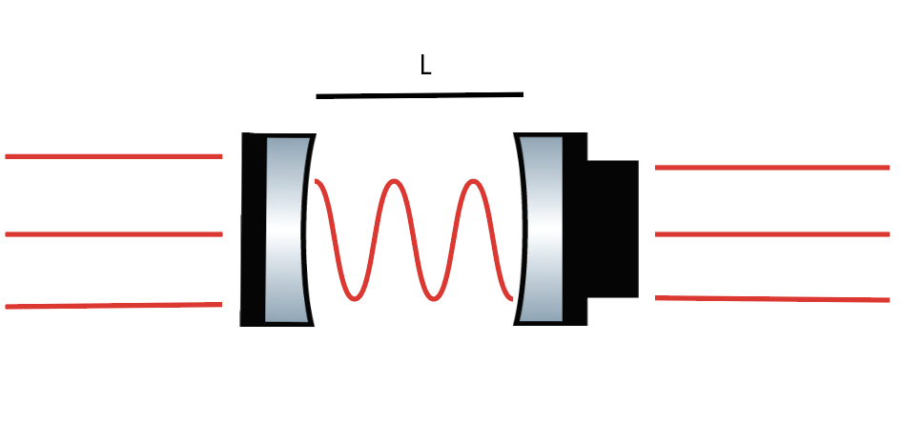
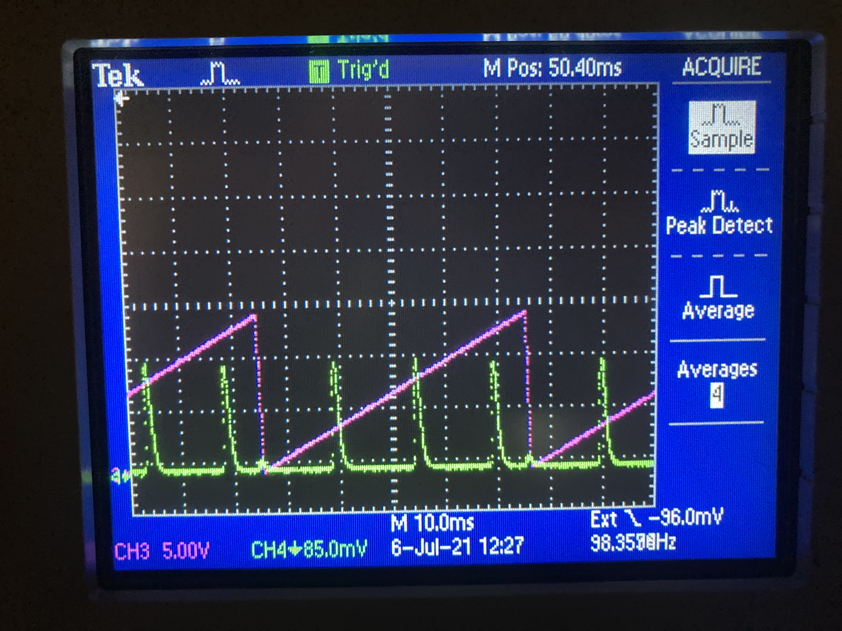
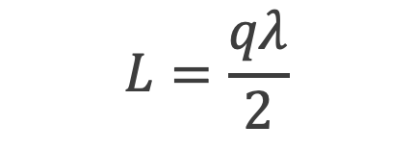
Fabry Perot Signal
$$L=\frac{qλ}{2}$$
FSR=1.5 GHz

Slide 5
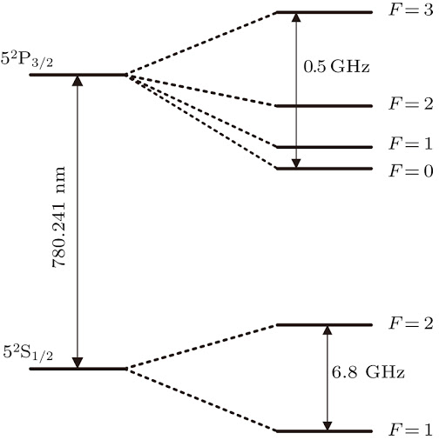
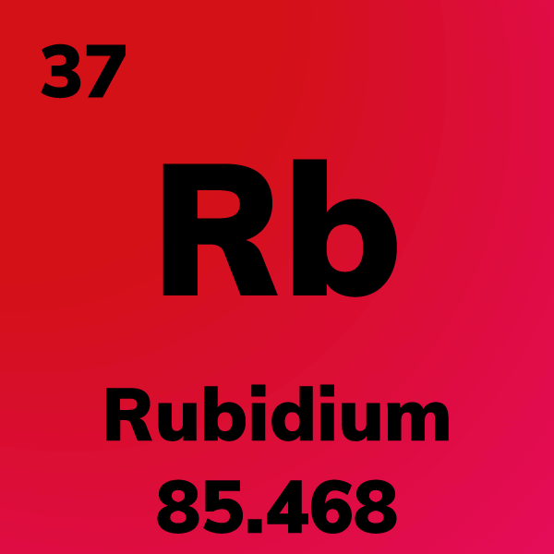
Saturated Absorption
http://cpb.iphy.ac.cn/article/2017/1899/cpb_26_8_080701/cpb_26_8_080701_f1.jpg.html

Slide 6
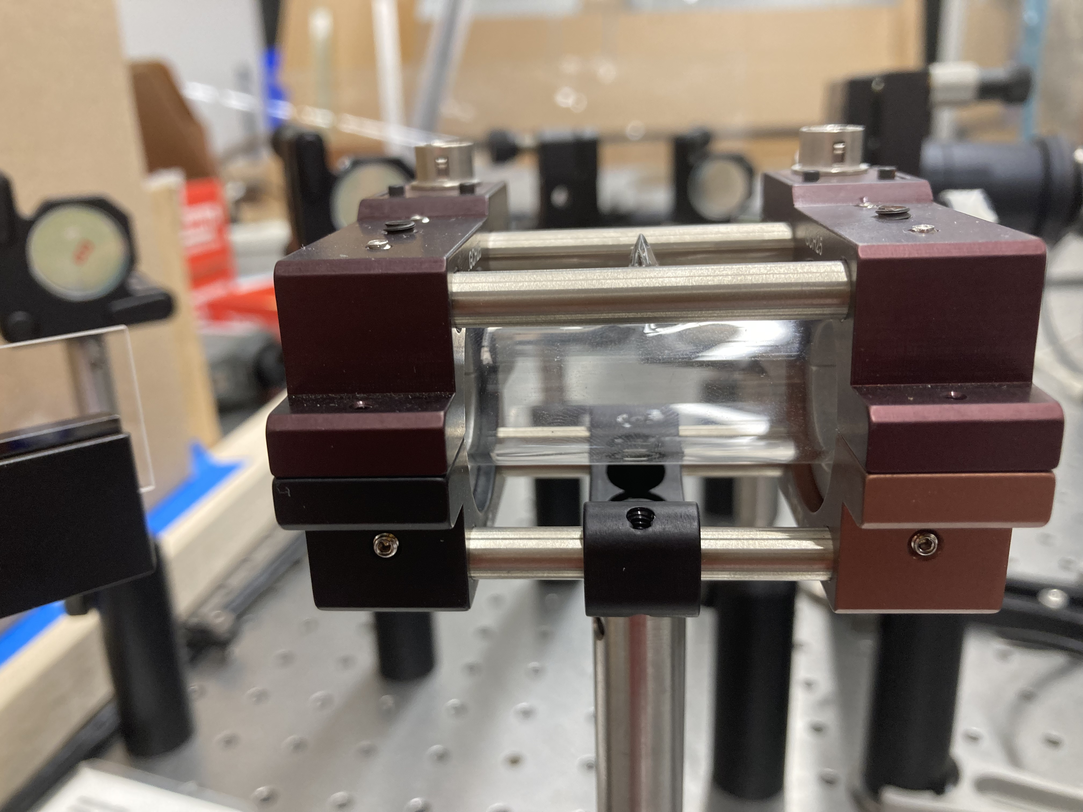
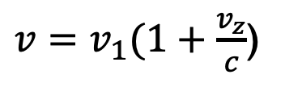
Doppler Broadening
$v=v_{1}(1+\frac{v_{z}}{c}$)

Slide 7
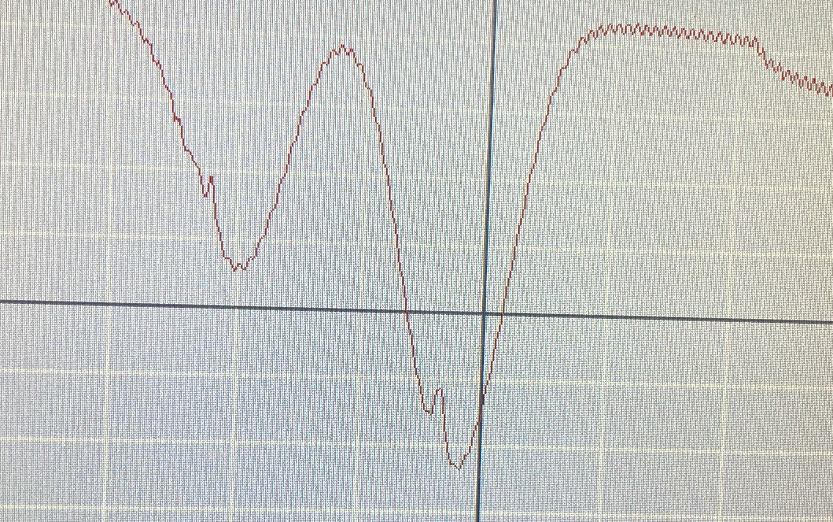
Doppler-Free Spectroscopy
Probe Beam
PD
Pump Beam

Slide 8
References
ThorLabs. (n.d.). Saturated Absorption Spectroscopy Systems. https://www.thorlabs.com/newgrouppage9.cfm?objectgroup_id=5616.
ThorLabs. (n.d.). Scanning Fabry-Perot Interferometers. https://www.thorlabs.com/newgrouppage9.cfm?objectgroup_id=859.
Weigand, W., Egbert, A., & Sadler, H. (2015). Absorption Spectroscopy of Rubidium Gas . University of San Diego.

